Slide 1
Load Flow Analysis
Summer Internship Seminar
19th May to 4th July, 2011
By:
Siddharth Bhal
Electrical Eng. Dept.
IIT Roorkee.

Slide 2
Outline
Introduction to RIL, Patalganga
Power system
Load flow
Motor Analysis
Conclusion

Slide 3
Introduction to RIL, Patalganga

Slide 4
RIL
RIL, Patalganga
Largest private sector company in India.
Annual revenues ~ US$ 58.5 billion.
126th position in Fortune Global 2000 list.
Core business: petrochemicals and textiles.
Mother plant.
Backward Vertical integration
Complex power system
Notes:
Major subsidiaries
Reliance Life Sciences
Reliance Industrial Infrastructure Limited
Reliance Solar

Slide 5
Products manufactured | Raw materials
Para Xylene (Px) | Naphtha
Purified Terephthalic Acid (PTA) | Para Xylene
Polyester Filament Yarn (PFY) | PTA & MEG
Polyester Staple Fibre (PSF) | PTA & MEG
Linear Alkyl Benzene (LAB) | Kerosene & paraffin
Name of Plant | Commissioned Year
Polyester Filament Yarn (PFY) | Oct.1982
Polyester Staple Fiber (PSF) | Mar.1986
Purified Terephthalic Acid (PTA) | Feb.1988
Paraxylene Plant (PX) | Nov.1988
Linear Alkyl Benzene Plant (LAB) | Nov. 1987
L A B (Front End) | Mar.1992

Slide 6
Power System

Slide 7
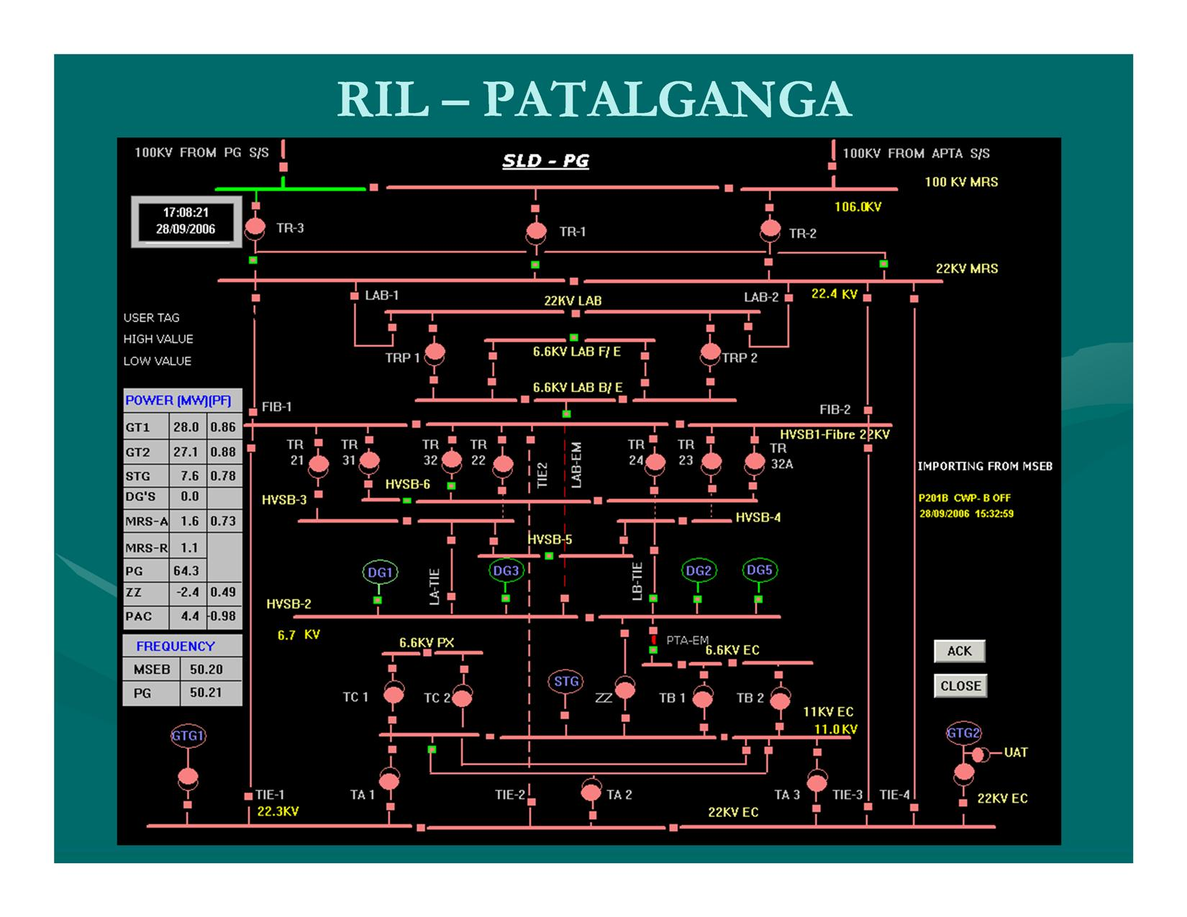

Slide 8
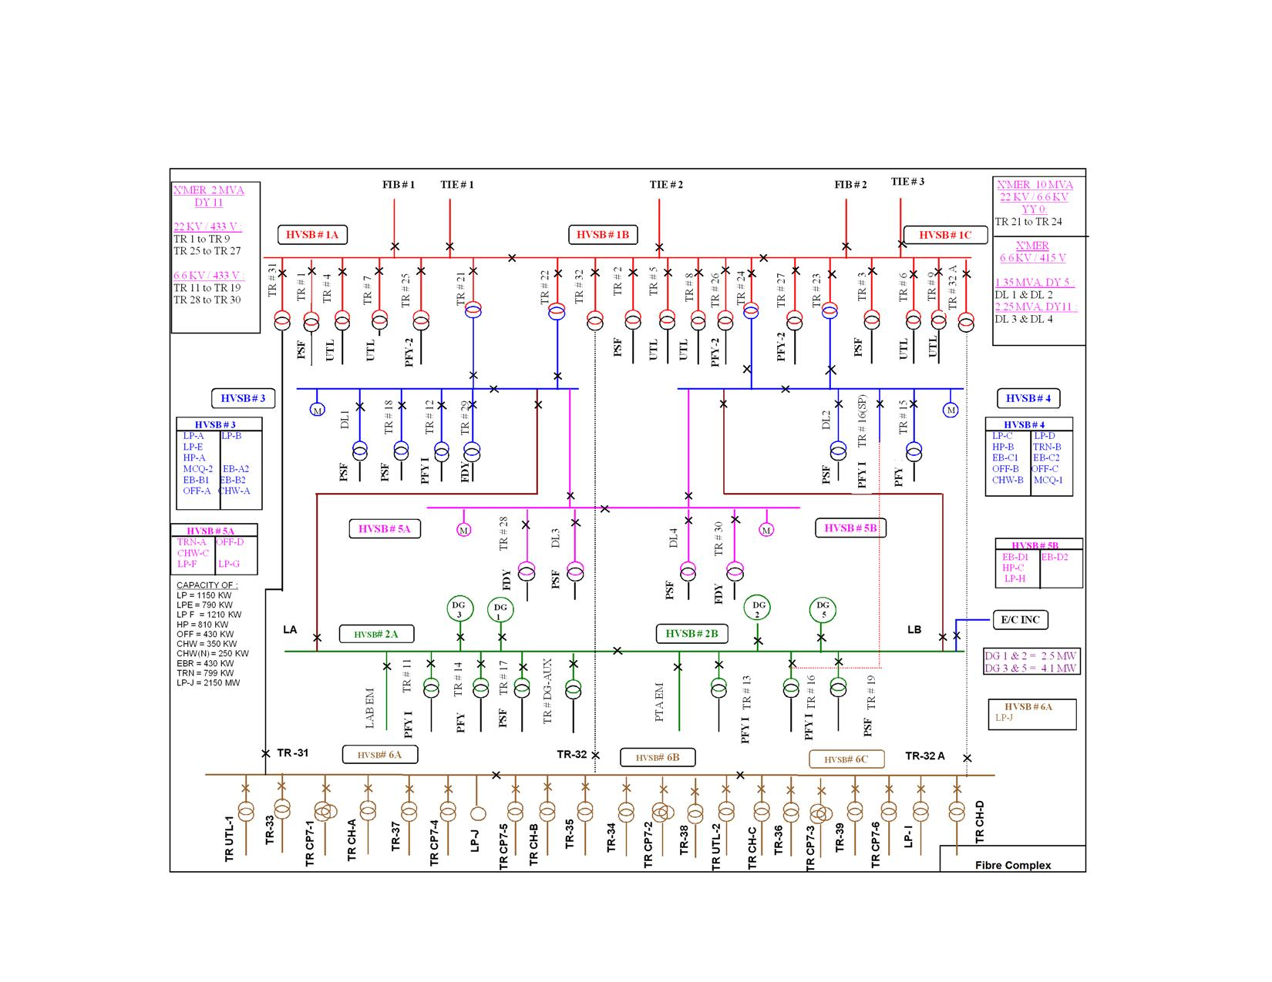

Slide 9
Load Flow Analysis
Using ETAP

Slide 10
Assumptions
Grid Fault Level
Generators Output
Motor power factors
Lumped loads
ENC load equally divided
Cable lengths
Initial voltage
DG sets excluded
Notes:
80% constant KVA loads (motors) and
20% constant impedence loads

Slide 11
Schema 1
Fibre load: | 31.6 MW. | STG output: | 8 MW @ 79% pf
ENC load: | 19.6 MW | Zig-Zag Tranf. | Off
GTG1 output: | 27 MW @ 88% pf. | LA,LB: | On
GTG2 output: | 27 MW @ 84% pf | MSEB Grid | Charged
DG’s | Off | TA-1 | On
TA-2 | On | TA-3 | On

Slide 12
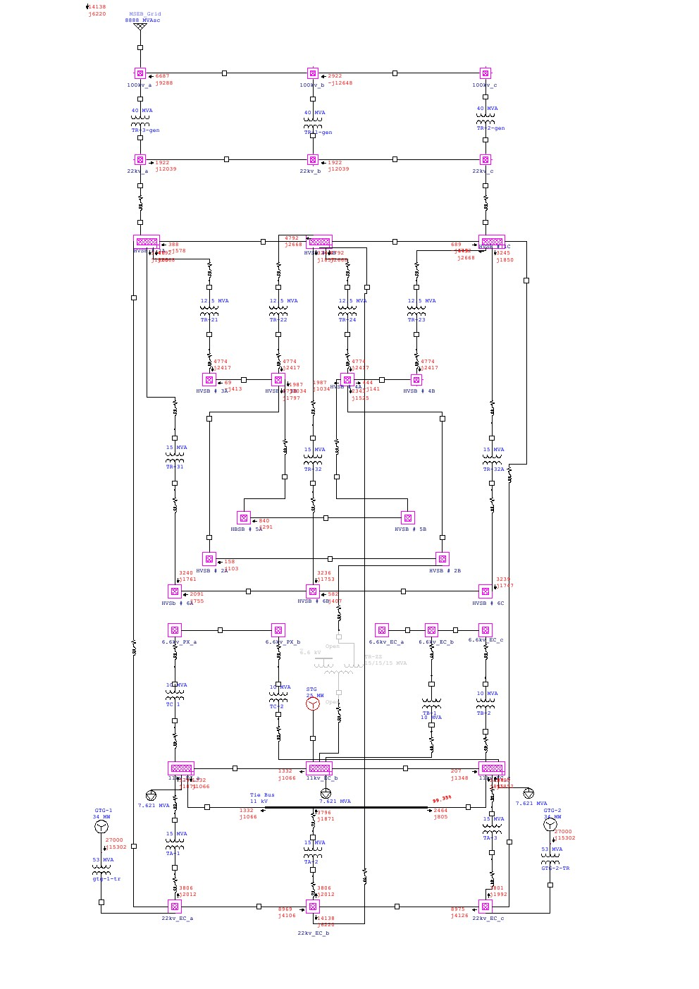

Slide 14
Motor startup analysis

Slide 15
LLP-J Motor Specifications
Frame size: | 8012 | Rated Output: | 2125 KW
Voltage Level: | 11 Kv | Service factor: | 1
Operating Freq | 50 Hz. | Rated Speed | 2977 rpm
Efficiency(1/2 load) | 94.4 | Full Load Ampere | 127 amp
Efficiency(3/4 load) | 95.0 | Locked Rotor Ampere | 742 amp
Efficiency(full load) | 94.9 | No Load Ampere | 17.1 amp
PF (1/2 Load) | 91.5 | Full load torque | 5028 lb-ft
PF (3/4 Load) | 92.8 | Starting Torque | 3268 lb-ft
PF (Full Load) | 92.5 | Breakdown Torque | 11313 lb-ft
Rotor wk² | 1244 lbs-ft² | Motor Weight | 26700 lbs
Customer wk² | 1602 lbs-ft² | Rotor Weight | 4014 lbs

Slide 16
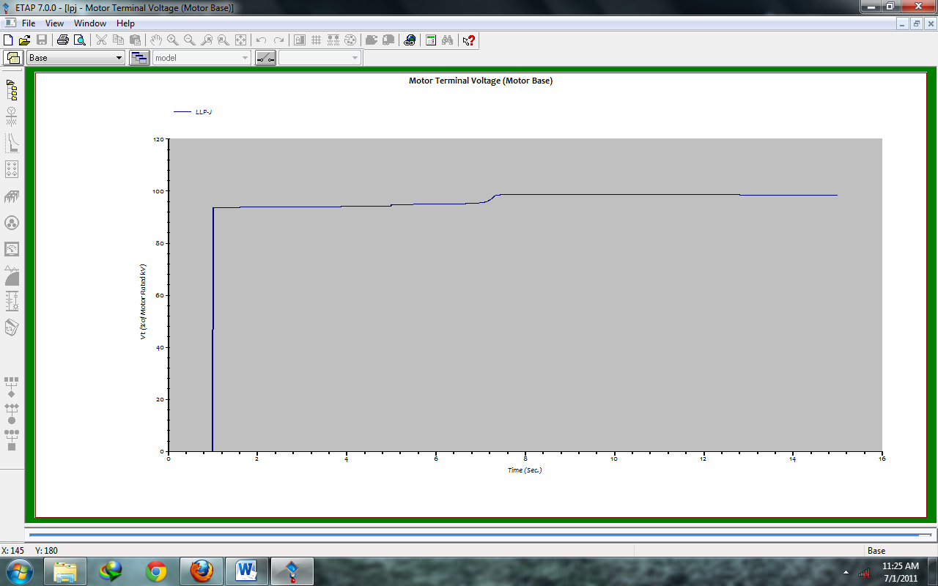
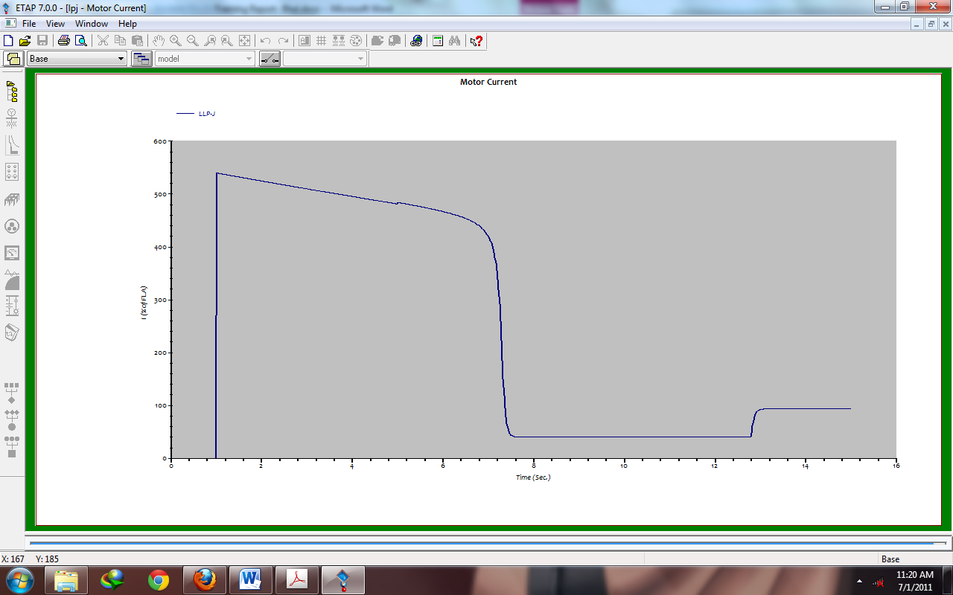
Motor Terminal Voltage (% of motor rated volt) vs Time (sec)
Motor Current (amp) vs Time (sec)

Slide 17
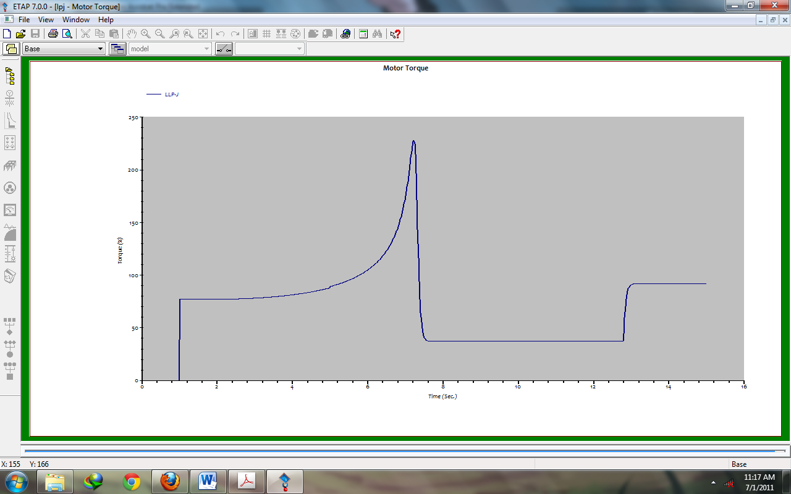
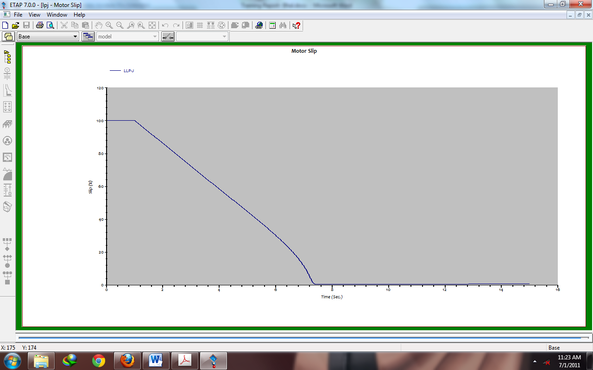
Motor Torque vs Time(sec)
Motor Slip vs Time(sec)

Slide 18
Conclusion
Industrial application of electrical machines
Working Principles in Large Scale Industries
ETAP
Professional life of the engineers
Safety standards and Maintenance practices

Slide 19
Thank you!

